Slide 1

MU5MEF16 - (MEC 655) Numerical Methods for Fluid Mechanics
Comp Mech
Collapse of a column of grain
DUVIVIER Valentin
10/25/2021

Slide 2
Plan
Recall problem
μ(I) - rheology
Numerical study
Discretization - Implementation
Dynamic behavior
Consistency model
Discrete solid case
Other models
Summarizing collapse behavior
Conclusion

Slide 3
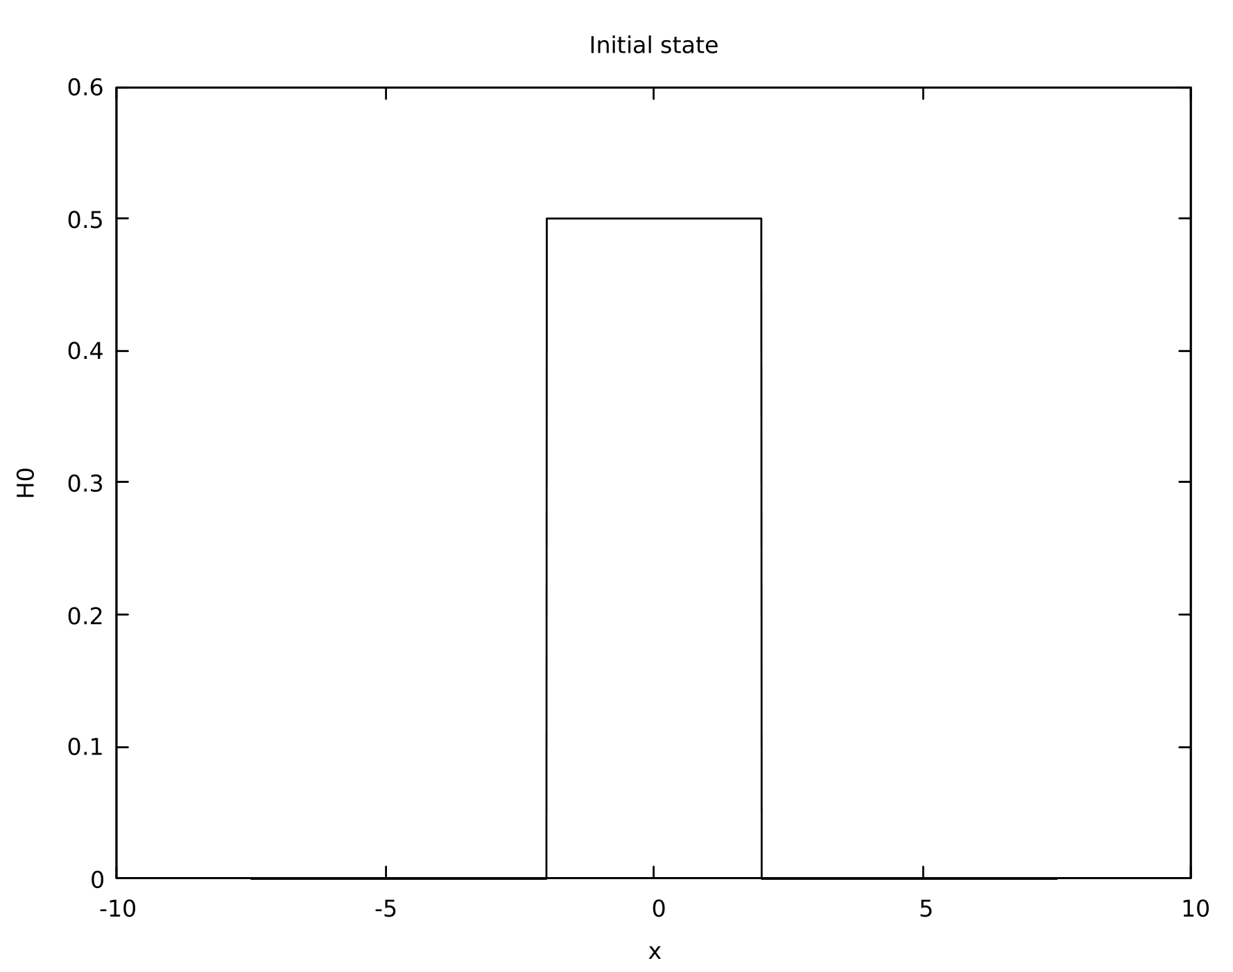
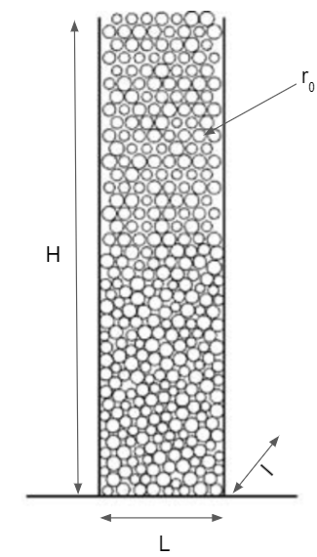
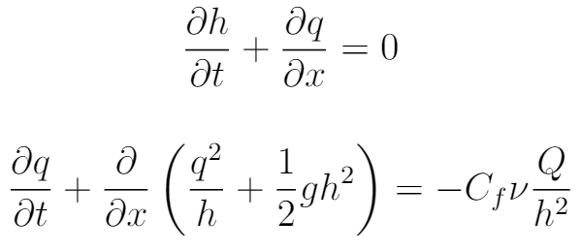
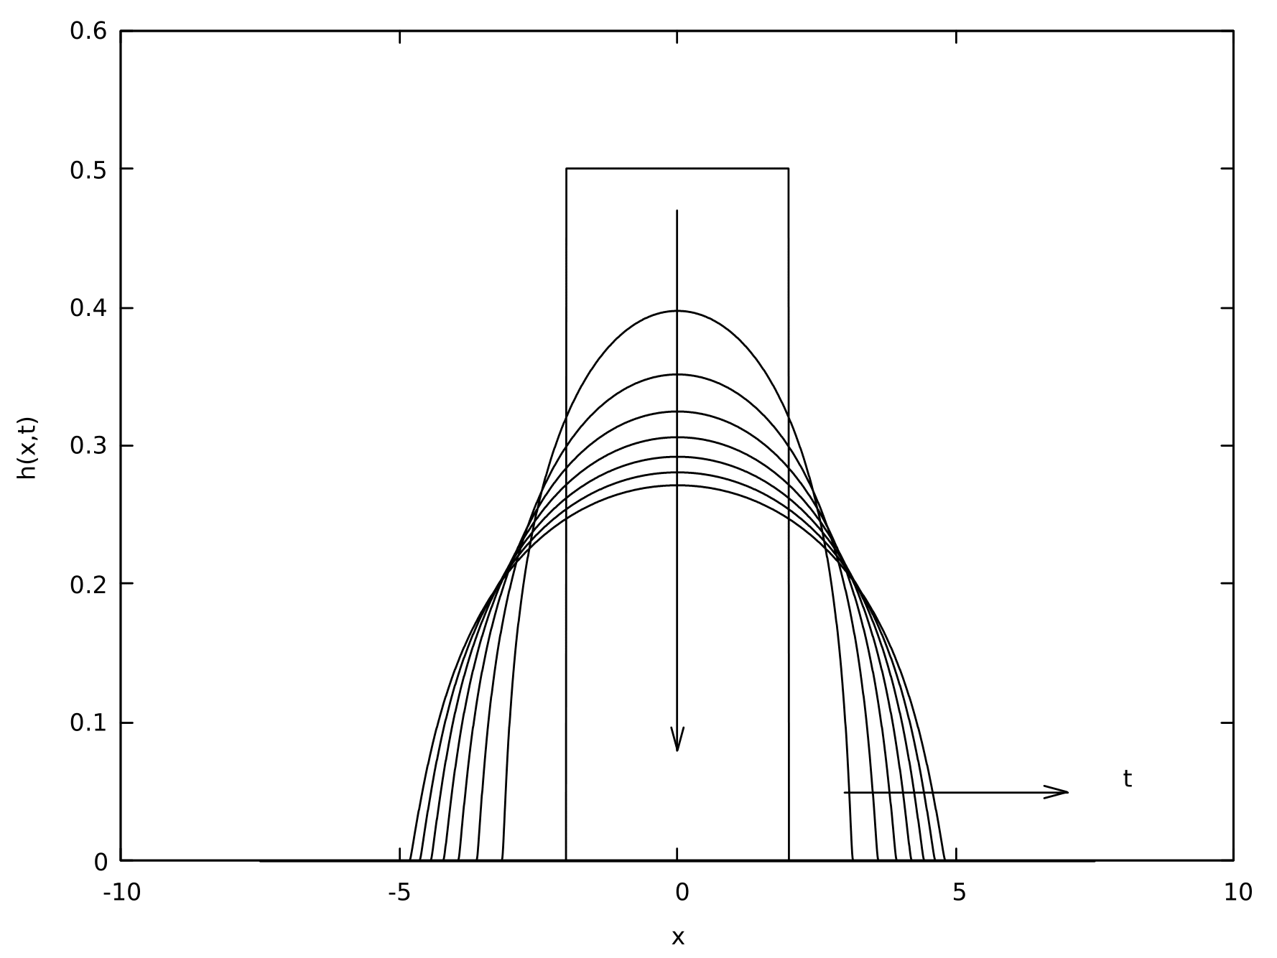

Recall 1st problem
fig 2. fluid system
Convective terms
Poiseuille viscous term

Slide 4
μ(I) - rheology model
Physical link system / model
Models most cases
Viscosity of a flow ran by solids

Slide 5
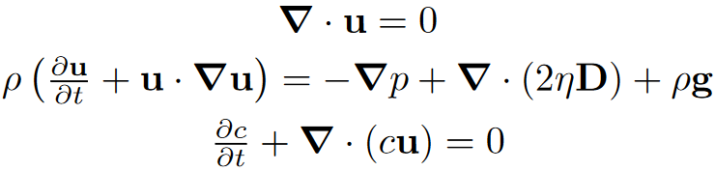
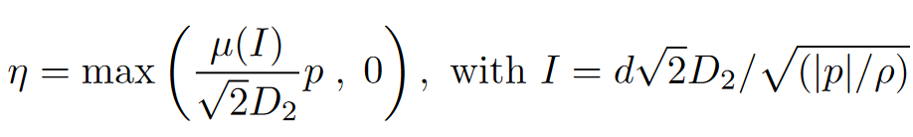


μ(I) - rheology model
incompressible
movement quantity conservation
color function

Slide 6
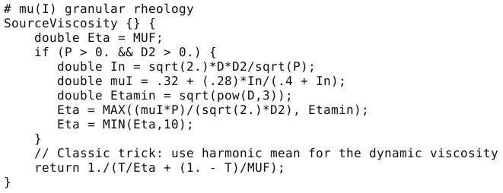
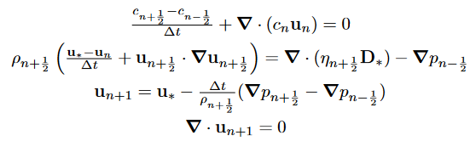
Discretization - Implementation

Slide 7
Dynamic behavior
non viscous bottom
intern shape
finite spreading

Slide 8
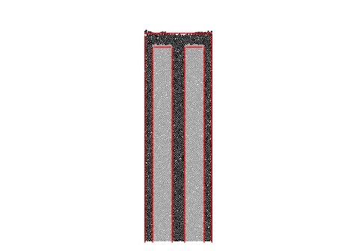
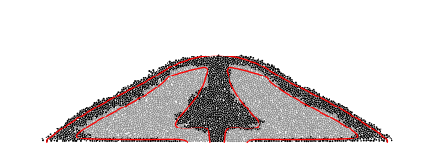

Discrete solid case
μ(I) rheology
μ(I) vs discrete mechanics
inner and outer behavior

Slide 9
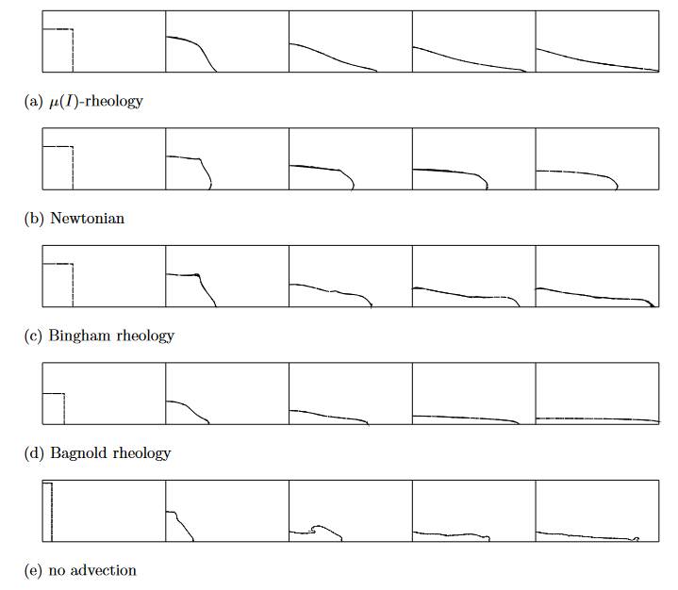
Other models
μ(I)
stops
μ = cst
doesn’t stop
mix viscous behaviors
stops
μ = ρ d² √2 D₂
doesn’t stop
linear μ(I)
stops
Confirmation μ(I) methodology and approach with I term

Slide 10
Conclusion
Recovery of most the shape
Model developed last decade → more to come from slender approach
Combinatory behaviors and approaches

Slide 11
Bibliography
http://www.lmm.jussieu.fr/~lagree/TEXTES/PDF/JFMcollapsePYLLSSP11.pdf#cite.midi04
http://www.lmm.jussieu.fr/~lagree/SOURCES/GERRIS/BAGNOLDP/BAGNOLDP.pdf
http://basilisk.fr/sandbox/M1EMN/Exemples/granular_column_cohesif.c#if-quadtree
http://basilisk.fr/sandbox/M1EMN/Exemples/bingham_collapse_noSV.c

